Slide 1

FACE MASK DETECTION SYSTEM
USER MANUAL
Ananya Adivi

Slide 2
CONTENTS
Acknowledgements
About Me
Internship journey
About my App
How to Operate my Application
Tool-Kit Walkthrough
Contact Me
01
02
03
04
05
06
07

Slide 3

01 ACKNOWLEDGEMENTS
First of all, I would just like to say that I am grateful to everyone who has helped me gain the opportunity to create this project and be able to enhance my own skills. Thank you to my parents, mentors, fellow peers (and YouTube videos) for helping me work towards achieving greater things.

Slide 4

ABOUT ME!
02
Hello!
My name is Ananya Adivi and I’m 17 years old, and I’ currently in Year 12.
I’m from Hyderabad, India, but I’m brought up in Dubai, UAE.
I have a number of interests like Art and Reading, but Coding is something I put a lot of effort in learning.
This opportunity has led me to learn various things about AI and how to implement it in creating applications, like the one I’ve focused on for this project.

Slide 5

INTERNSHIP JOURNEY
03
The internship with Clevered has been very helpful in venturing deep into the world of AI.
I’ve learnt many things, from voice recognition to object detection. With the tools and aid provided in the mentor sessions, I was able to enquire and learn many things that led me to create my project.

Slide 6
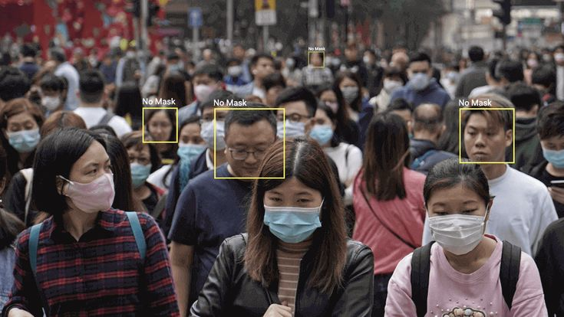
04 | ABOUT MY APPLICATION
Main Menu
My app focuses on Face Mask Detection. I’ve used object detection as my subject to implement. Face Mask Detection caught my eye, as it was a necessary system during COVID-19. I was always intrigued to find out how the system was created, and this project portrays my interest in the subject.
My app consists of two main parts:
Detecting if a person in an image is wearing a mask
Live face mask detection
These two functions are important to my project as they showcase the main goal of the project. They are very straightforward and easy to use.

Slide 7
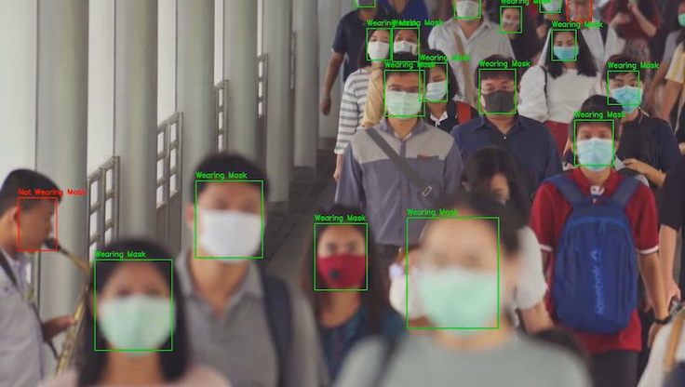
HOW TO OPERATE MY APPLICATION
Function 1 - DETECT MASK
Function 2 - LIVE DETECTION
Demo
05

Slide 8
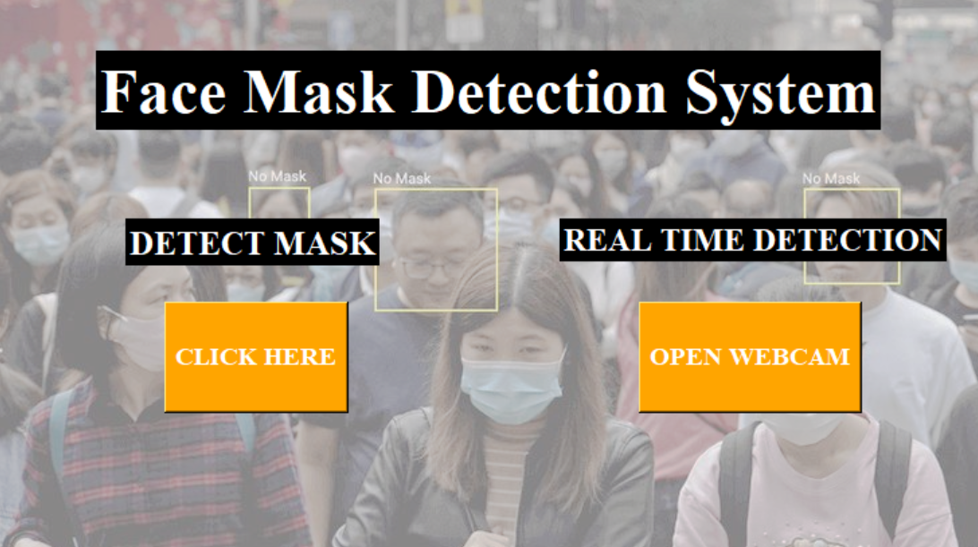
FUNCTION 1
DETECT MASK
This function takes the selected image and runs the code written to detect the mask

Slide 9
FUNCTION 2
REAL TIME DETECTION
This function opens the web camera from the user’s device and detects whether the person is wearing a face mask or not.
It is important to note that the code does not work properly if there is no proper lighting*

Slide 10
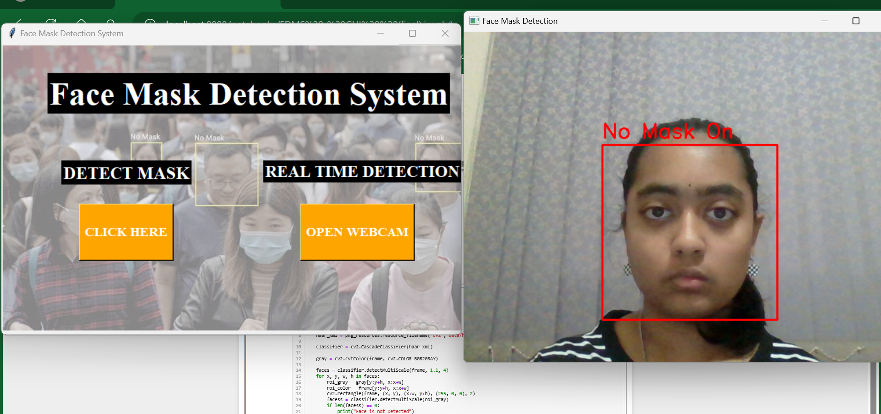
DEMO - REAL TIME DETECTION
WITHOUT MASK

Slide 11
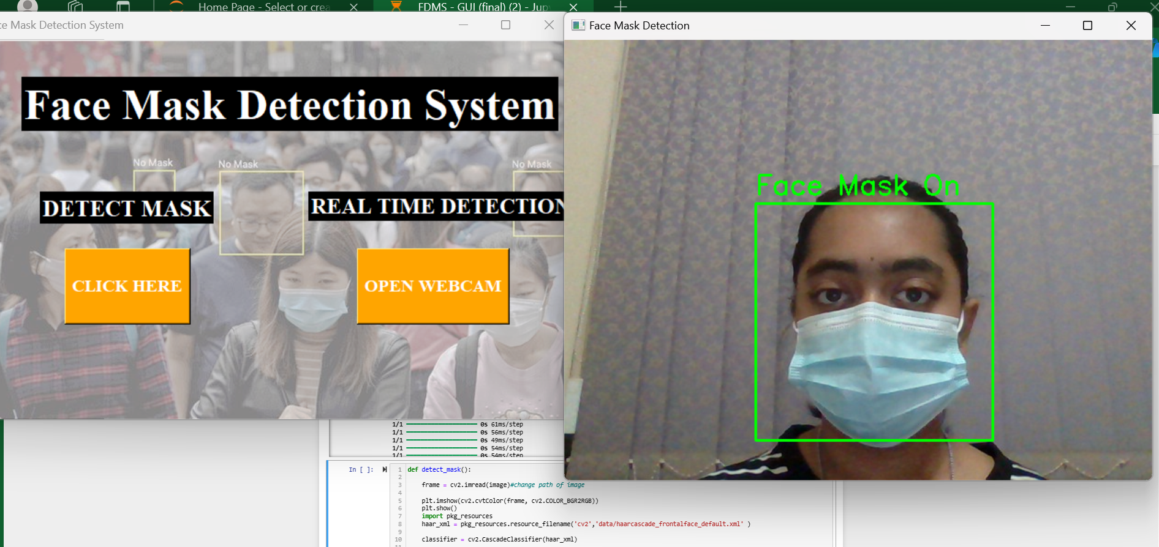
DEMO - REAL TIME DETECTION
WITH MASK

Slide 12
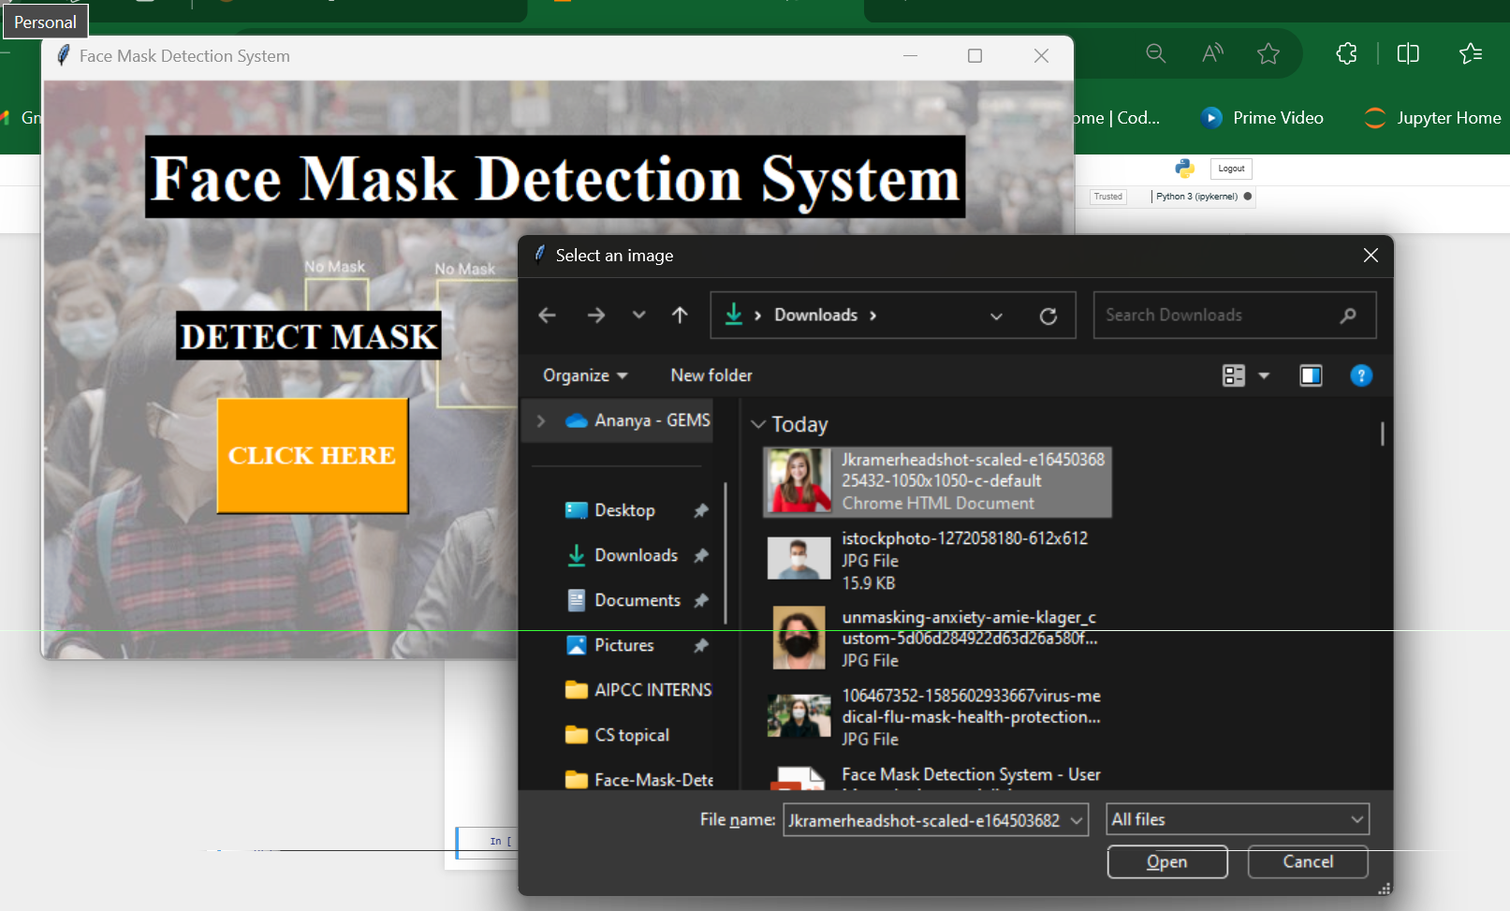
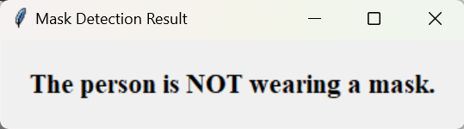
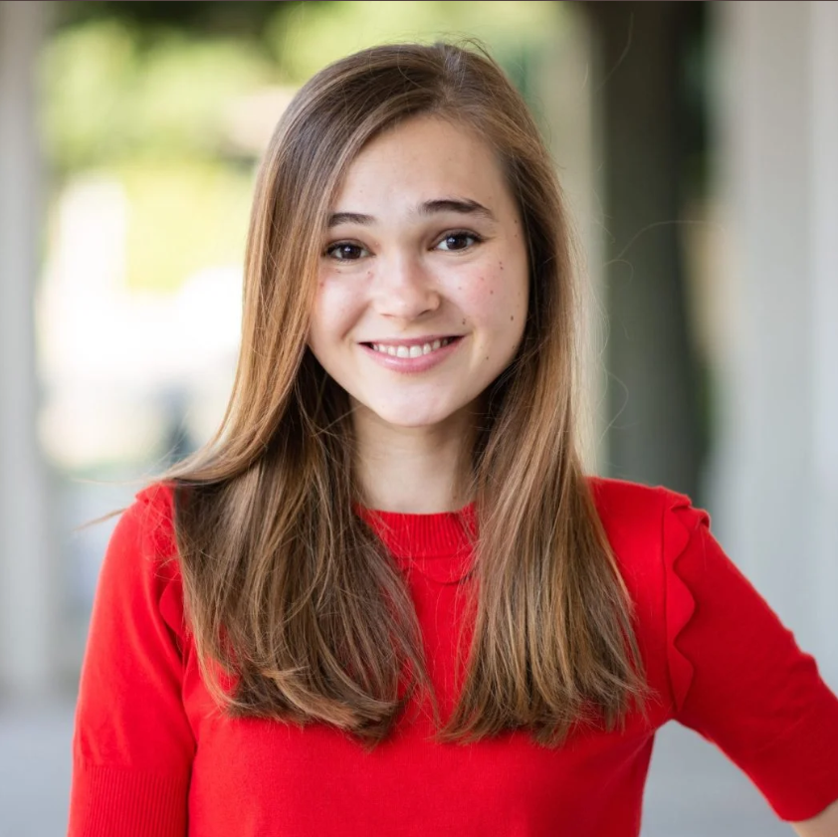
DEMO - DETECT MASK
USING AN IMAGE - WITHOUT MASK
OUTPUT:
IMAGE CHOSEN:

Slide 13
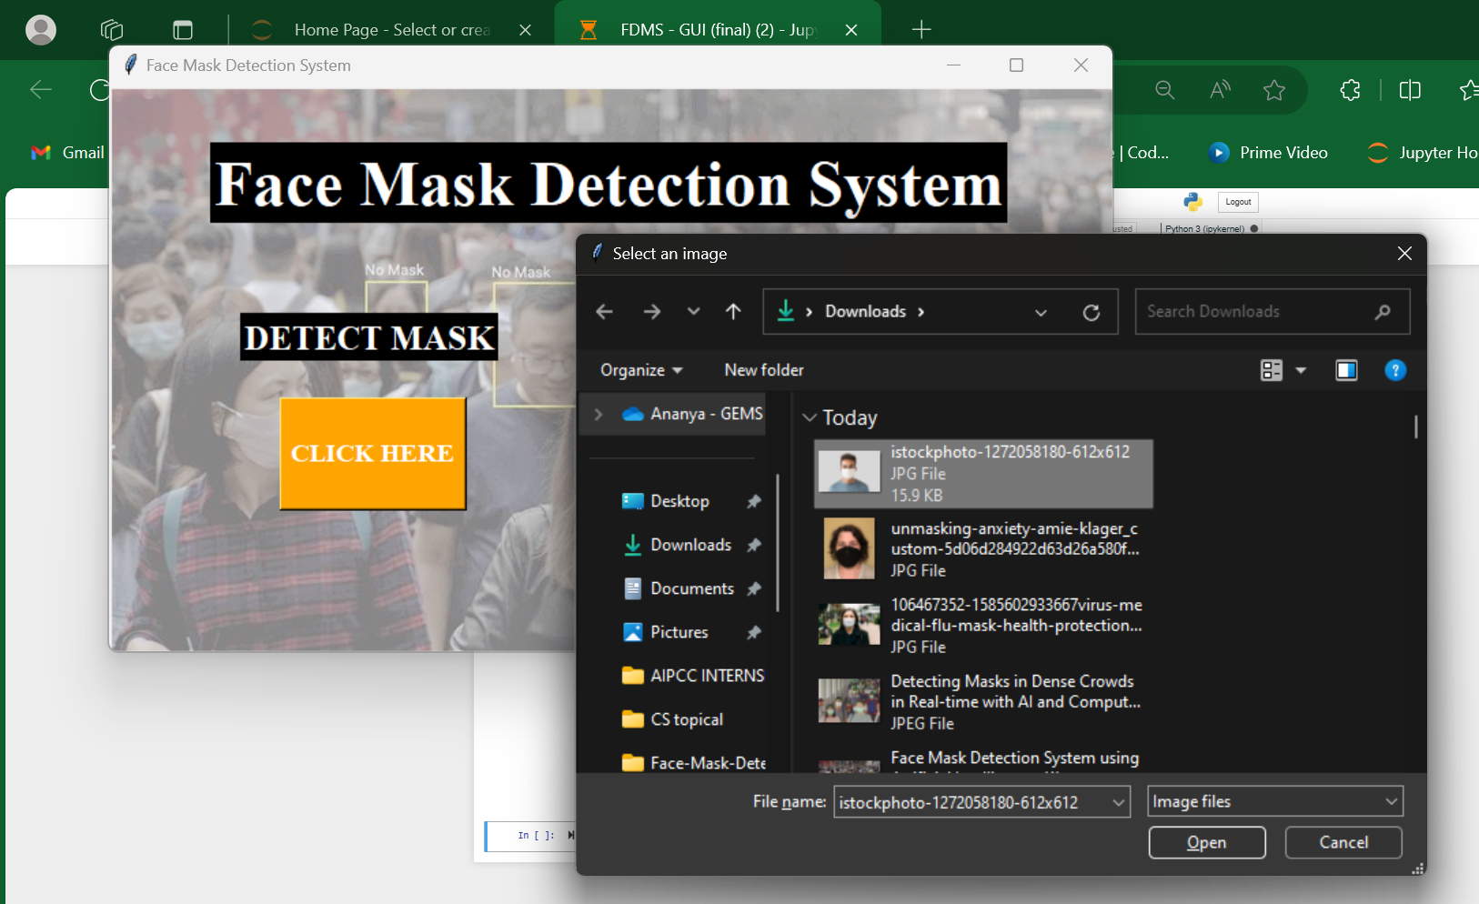
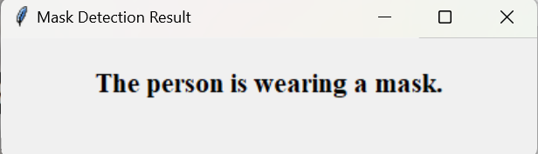
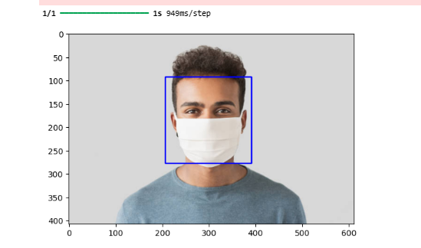
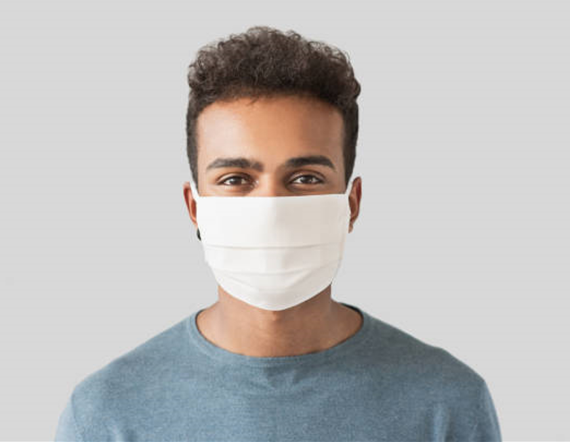
DEMO - DETECT MASK
USING AN IMAGE - WITH MASK
OUTPUT:
IMAGE CHOSEN:

Slide 14
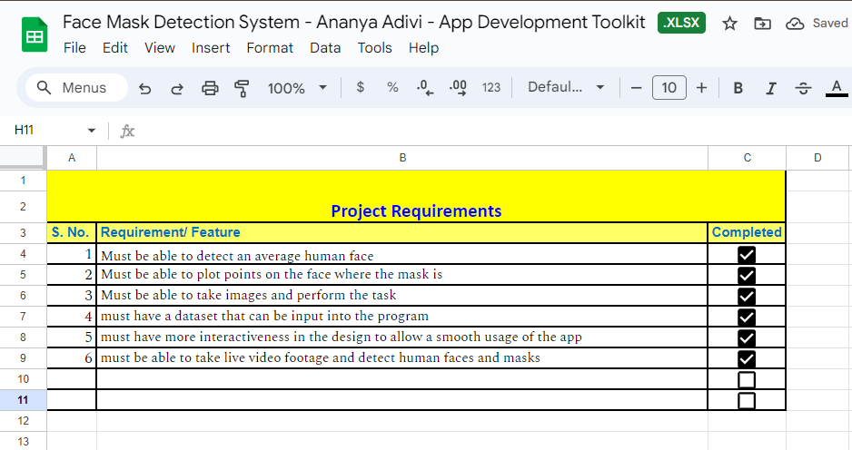
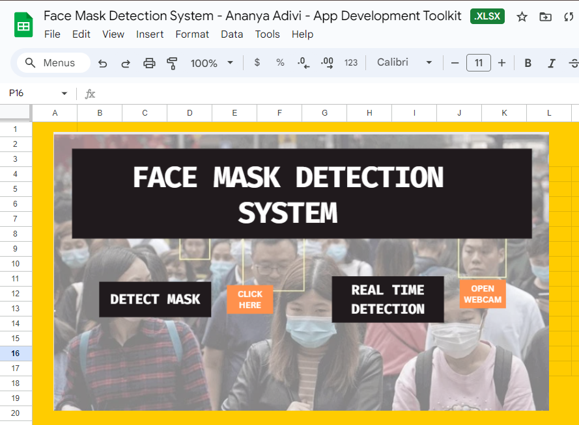
06 | APP DEVELOPMENT TOOL-KIT
PROJECT REQUIREMENTS & DESIGN USER INTERFACE
Link for Tool-Kit spreadsheet:
https://docs.google.com/spreadsheets/d/1AC4uODQuCjYJdXQMbvCZCrb-XGS6ODy7/edit?usp=sharing&ouid=115856861494110766051&rtpof=true&sd=true

Slide 15
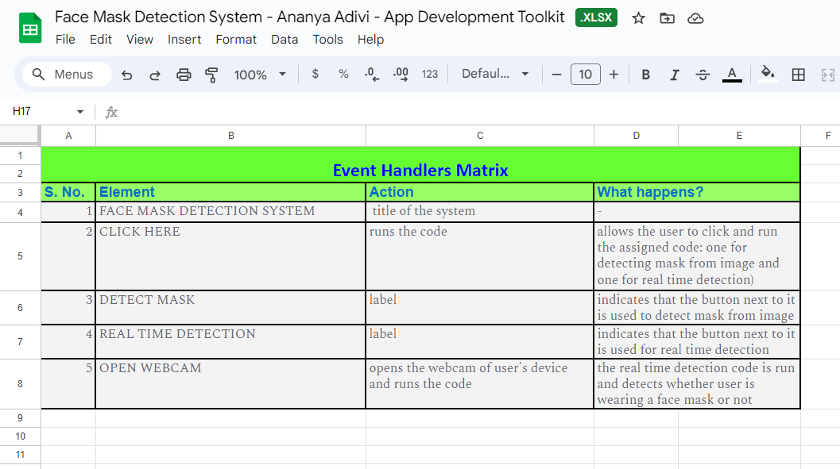
06 | APP DEVELOPMENT TOOL-KIT
EVENT HANDLERS
Link for Tool-Kit spreadsheet:
https://docs.google.com/spreadsheets/d/1AC4uODQuCjYJdXQMbvCZCrb-XGS6ODy7/edit?usp=sharing&ouid=115856861494110766051&rtpof=true&sd=true

Slide 16
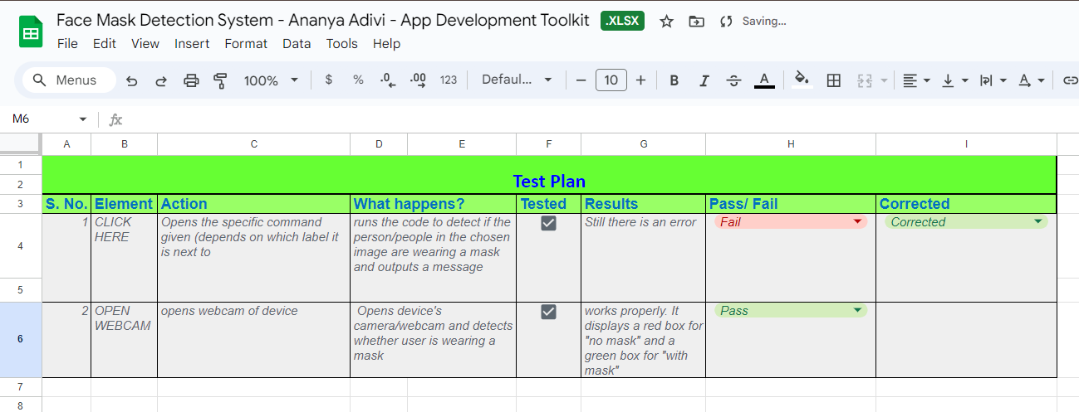
06 | APP DEVELOPMENT TOOL-KIT
TEST PLAN
Link for Tool-Kit spreadsheet:
https://docs.google.com/spreadsheets/d/1AC4uODQuCjYJdXQMbvCZCrb-XGS6ODy7/edit?usp=sharing&ouid=115856861494110766051&rtpof=true&sd=true

Slide 17

CONTACT ME!
07
If you have any further queries or suggestions, please contact me via the following email:
ananya_adivi@outlook.com

Slide 18
THANK YOU! :)

